Slide 1

PROJECT EXHIBITION -1
Start now!

Slide 2
TITLE OF THE PROJECT
MEMEBRS AND MENTOR

Slide 3
VIT INVENTORY
MEMBERS: - 1. Ashutosh Kumar 2. Sparsh Jain 3. Shubham Mishra 4. Shauryan Bhardwaj 5. Shrey Srivastava MENTOR-PROF. ANAND MOTWANI

Slide 4
INTRODUCTION
Introduction
Objective
Proposal
Novelty
Existing Work
Other
As this is the time when the students are learning from home , there are the certain things which they want to access for their betterment of studies.
Most of the Students especially in the engineering field, want to set the target and want to score good Grades and GPA so due to the inner process of colleges they even don’t know that how they can achieve required CGPA and GPA i.e in what subject they should target what grade to attain the targeted CGPA.
Even they don’t have access to check their attendance that how many classes they can leave in case of emergency without appearing in DEBAR LIST in VIT.
Hence for solving these problems we the TECHION group has come up with an initiative to design such a platform where the students can continue their learning from home easily with all the resource which they want during this time. .
And we have given this platform a name that is VIT INVENTORY

Slide 5

Problem Statement
VIT UNIVERSITY offers its students a chance to select their teachers for the semester. It is unknown to students that who are those teachers who should be most likely to choose, more likely to choose and who are satisfactory, so this problem can be solved so that they have a excellent semester and they also enjoy learning.

Slide 6

OBJECTIVE
Introduction
Objective
Proposal
Novelty
Existing Work
Other
THE OBJECTIVE OF THIS PROJECT IS TO DESIGN A PLATFORM FOR VIT STUDENTS AND TO INTEGRATE ALL THE REQUIREMENTS OF STUDENT UNDER ONE DOMAIN SO THAT THEY CONTINUE THEIR ONLINE EDUCATION EASILY

Slide 7

Introduction
Objective
Proposal
Novelty
Existing Work
Other
For fulfilling the objective of our project , we will design a website where we will integrate all of the resources which VIT students wants to access during their learning, under this we will design a GPA , CGPA calculator which will help them to compute their result from grades and also help them to set a target for upcoming exams , they will also have attendance calculator which will help them in keeping track of their attendance. Even for solving FFCS problem we will design the FFCS helper i.e that is teacher review system where the students can give reviews on teacher based on most likely, more likely and the satisfactory one. From this the student will get great help in the ffcs.

Slide 8

Introduction
Objective
Proposal
Novelty
Existing Work
Other
1. There are the CGPA Estimators which can tell you that how much GPA you should target to achieve the targeted CGPA for one sem only
2. There are many Attendance calculator which only calculates the Attendance percentage
3. There is no Faculty review system for the students of VIT so that it can help them during the FFCS

Slide 9
Proposed Work
For achieving our problem statement, we have designed a website integrated with many resources, with no more common features and functionalities.
We have GPA and CGPA calculator having functionalities as existing one
CGPA estimator is designed in such a manner that targeted GPA is not only be shown for the one semester , but it will show that how many semester can be needed to achieve the desired CGPA with how much GPA in each semester
We have a Attendance calculator which will not output the attendance percentage, but according to it, this calculator will predict that how many classes you can miss so that your name don’t appear in DEBAR list.
For the Students of VIT BHOPAL we have Designed a TEACHER REVIEW SYSTEM, from there they can review their teacher of their choice and they can also see the average rating of every teacher

Slide 10

Introduction
Objective
Proposal
Novelty
METHODOLOGY
Other
For GPA calculator we have designed a form like page where USER will input the course , course credit and the grade achieved by him/her, and by this data the GPA of a user will be calculated.
For CGPA, we have also designed a form only, where user will input the semesters, the total credits in the semester and the GPA achieved in the semester, by this data the CGPA will be calculated.
For Attendance we have designed a page where user will input the Total classes in the semester and the number of classes missed from this it will output the number of classes the user can miss without appearing in the DEBAR list
We have Designed the CGPA estimator where USER will input the Desired CGPA, Current CGPA, Credits taken, Total credits till now, Current semester.
Lastly we have designed the Faculty review system, where we have designed the two forms first one is the Review form where students will give their review on the faculty and their response will get saved in the PHP-MYSQL database.
And from that database the avg rating will be retrieved through the Retrieval form .

Slide 11

Introduction
Objective
Proposal
Novelty
Existing Work
Other
Our group’s research is novel, because there may be GPA and CGPA calculator in other websites but our group has taken initiative in which we will put all the resources in the one website ,We will provide the attendance calculator through which they can keep track of their attendance in these time where everyone is involved in online education.
Even the student has to visit different websites for different resources , but from our website they can access all those resource which they can access from several different websites.
Even we have designed the faculty review system so that students will get benefit of that in the teacher choosing procedure

Slide 12

Hardware R
Objective
Proposal
Novelty
Existing Work
Other
Mainly It will run on every standard pc currently in use , But
1. The most Compatible Operating System is Windows 7, 8,10,11 ,Linux and Mac Os also
2. If the Processor is i5 or better than i5 then it is well and good otherwise our website can run on i3 processor also
3. If the system has 2GB RAM then also the user experience on the website will be good

Slide 13
Software Requirement
As we have Faculty review system in our website hence we need to store data for that, so for this purpose we have used My-Sql database and to establish the connection to the dom we have used PHP
Any operating system can be compatible if they are running in the standard PC in use for example-Windows 7,8,10,11 linux and Mac and Ubuntu
As we have designed calculators hence to perform calculations we have used Javascript
For local hosting we have used the live server feature of VS code editor
For implementing the files of the faculty review system we have used XAMPP software
There are many functions included in the code which will lead user to get their desired results
This website is compatible on any browser but highly recommended are chrome, Microsoft edge, firefox, opera

Slide 14

Literature R
Objective
Proposal
Novelty
Existing Work
Other
In present time, internet as become a source through which the students are able to continue their studies. They don’t have much resource to study, don’t have a target to achieve and they don’t even know that if emergency occurs then how many lectures they can miss so that maintain the decent attendance percentage.
Hence keeping these points in mind we have designed our website, which is easily accessible at any standard browser in any standard system. Here we have designed the CGPA estimator so that students can set targets, and through the attendance calculator they can see that how many classes they can miss so that their name will not appear in the debar list

Slide 15
Literature R
Objective
Proposal
Novelty
Existing Work
Other
There are many websites which provide the GPA calculator, CGPA calculator and estimators and we also have taken the reference of one but in our website we have enhanced the features CGPA estimator and Attendance calculator in our website
As VIT conducts FFCS but students get confused sometimes that whom to choose , hence for solving this we have designed the Faculty review system, where students can easily retrieve the review and post the review on the faculty, this is never designed by anyone in the past.
Hence we have designed the website so that user on any system can access it, If the user don’t have Smartphone and laptop also then he/she can access it from nearby cybercafes.

Slide 16

Module Description
Objective
Proposal
Novelty
Existing Work
Other
Here our website is divided majorly among modules,
Admin Mode
Student / user Mode
Here in the Student / user mode, the user can submit the data and retrieve the output, for example the review system, the students can submit the faculty name whom they want to review and the rating they want to give to that faculty, and even they can retrieve the review by just submitting the name of that faculty in the form and the average rating can be calculated through SQL query and the output will be shown with the help of PHP
In the student / user mode the student can input the data in the form and get the results in the CGPA, GPA ,attendance calculator and estimator

Slide 17
Module Description
Objective
Proposal
Novelty
Existing Work
Other
Now looking at Admin module, The admin is able to see the responses of the user which is submitted through the registration form in the review system, The admin can add the webpages in it, The admin maintains the website such that the user gets a good experience. The whole functionality of the calculators will be maintained by the admin.
The admin can change the UI of the website to enhance the user experience.

Slide 18
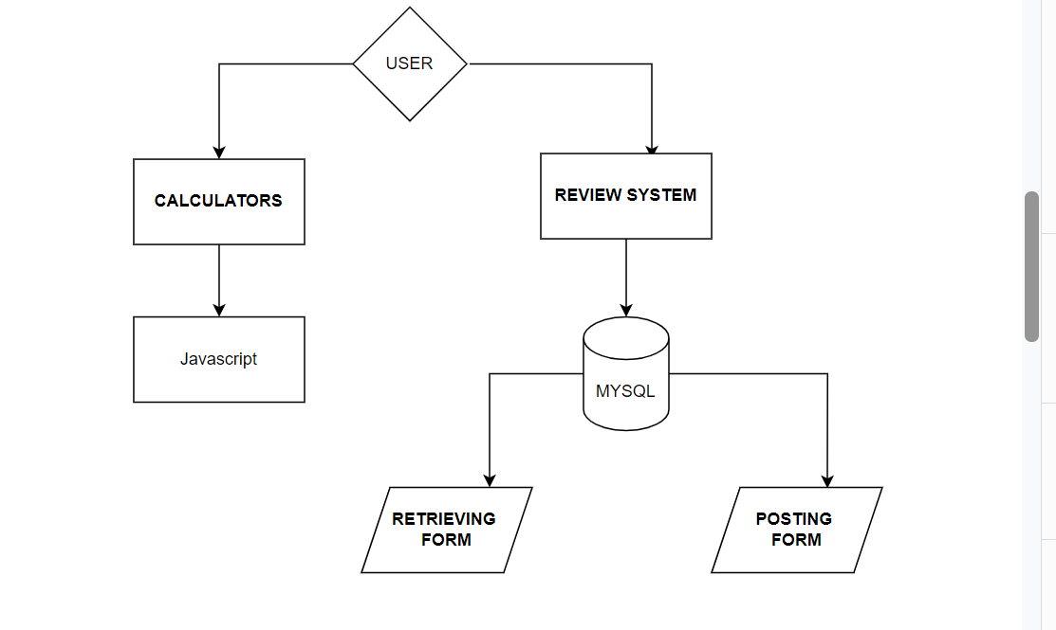
Modular flow diagram- User

Slide 19
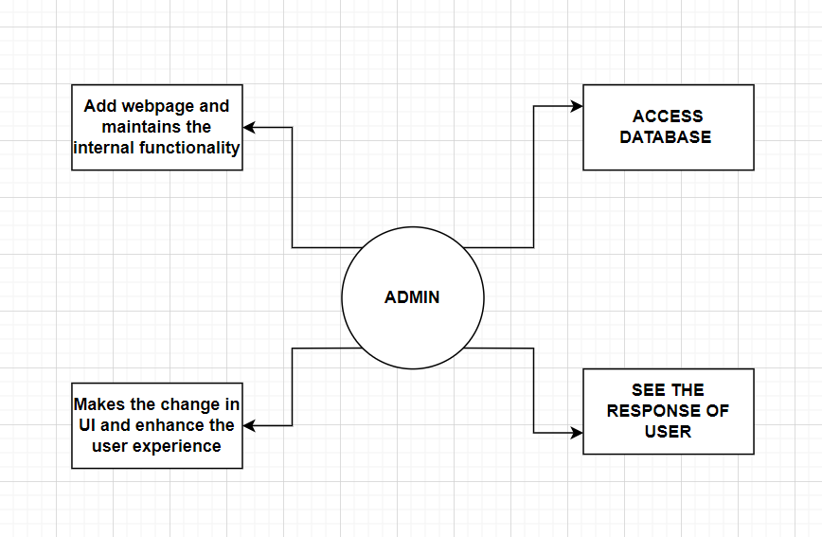
Admin Modular Flow Diagaram

Slide 20
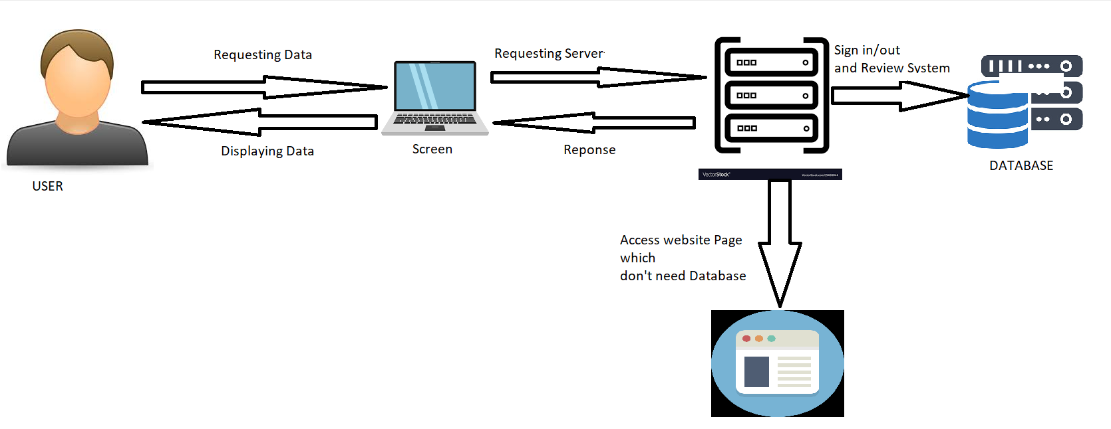
OVERALL ARCHITECTURE DIAGRAM

Slide 21
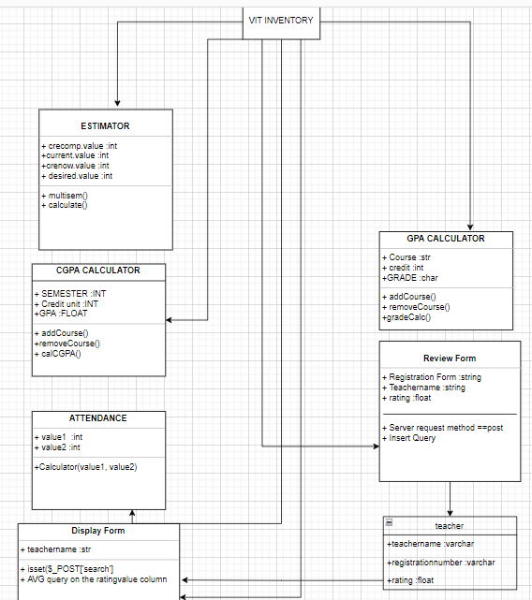

Slide 22
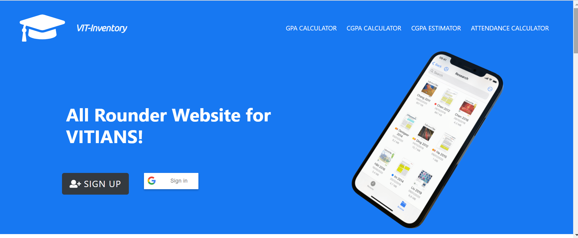

Slide 23
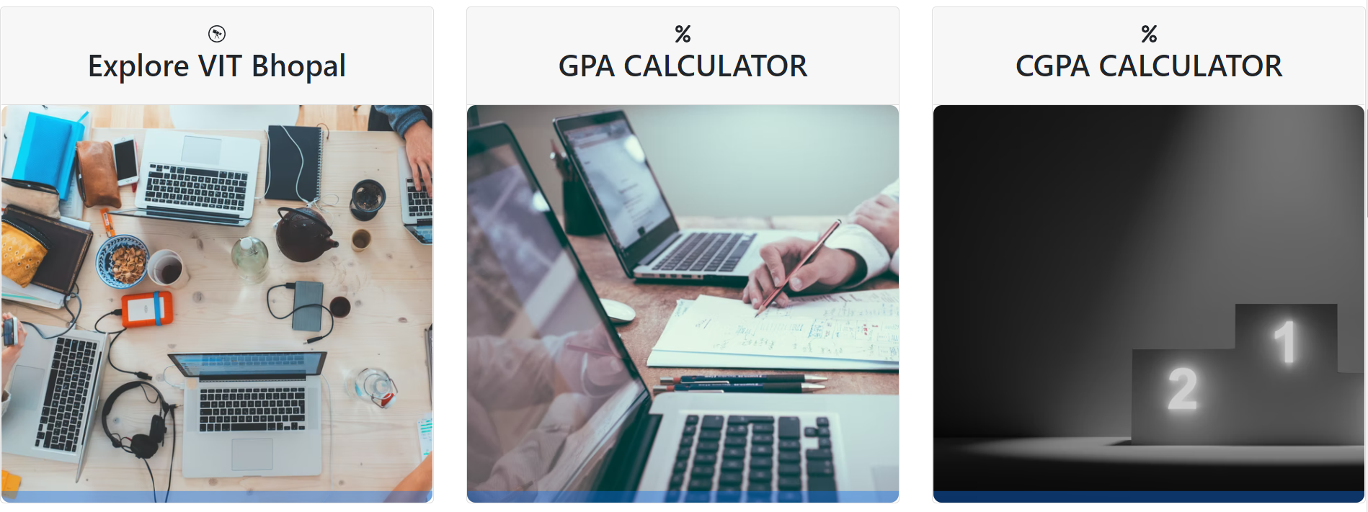

Slide 24
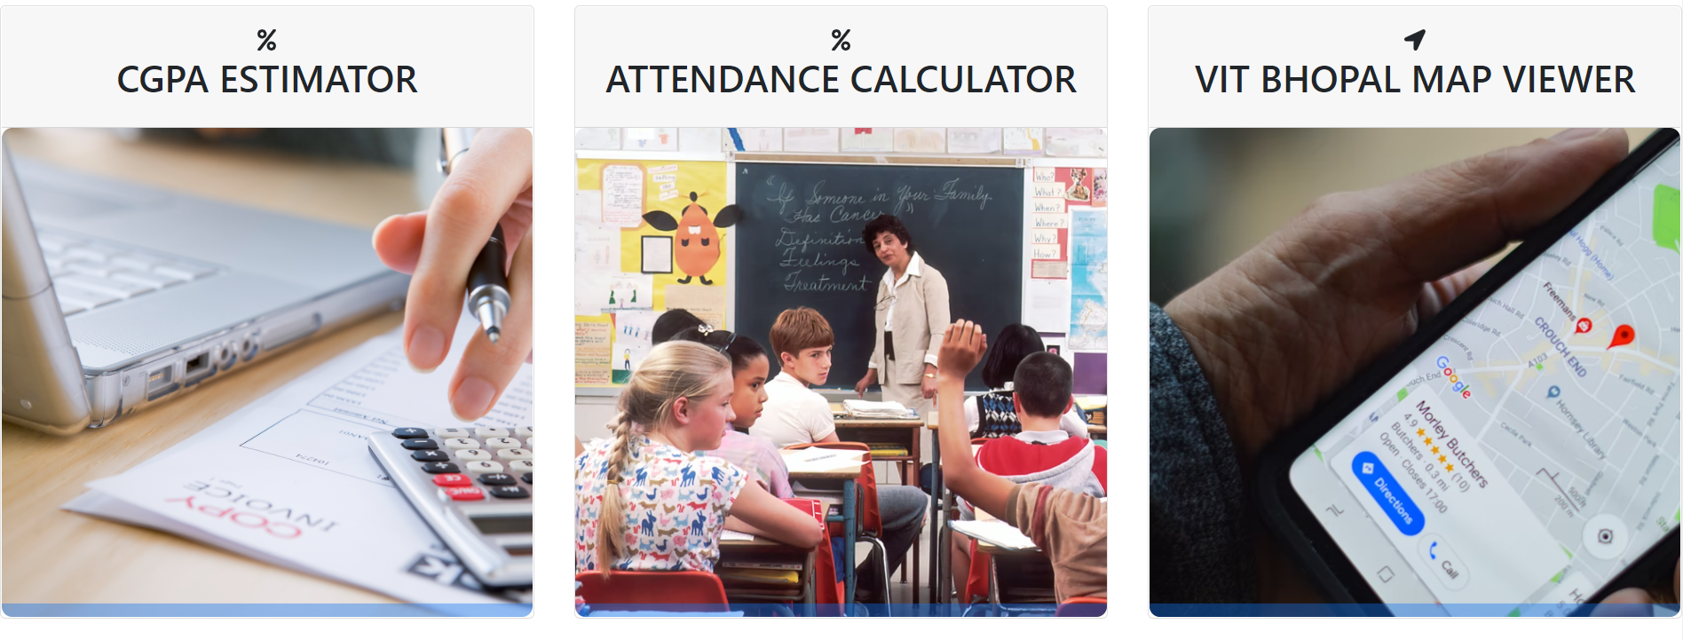

Slide 25
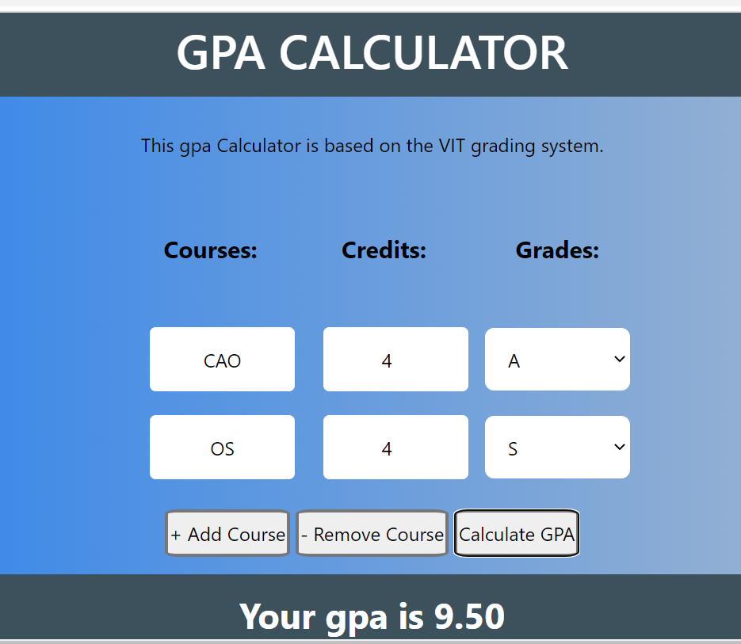

Slide 26
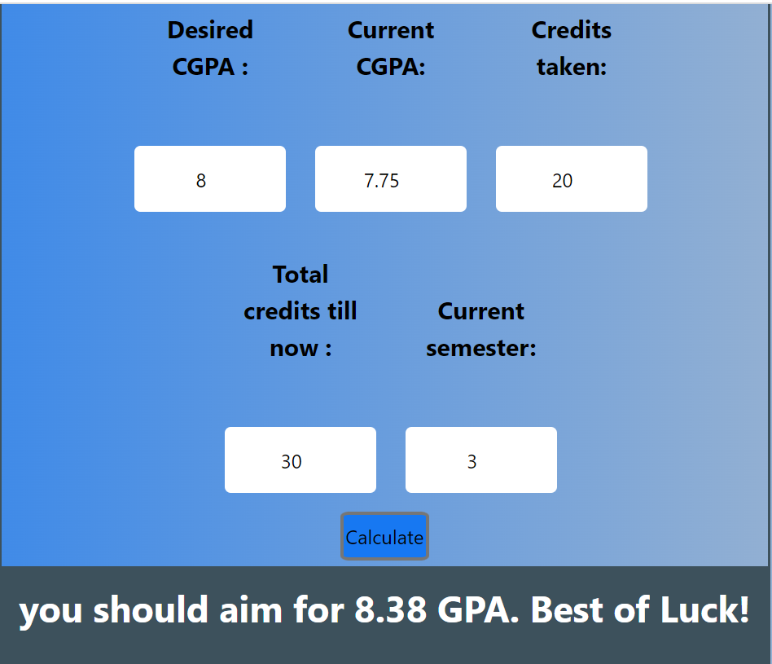
CGPA ESTIMATOR

Slide 27
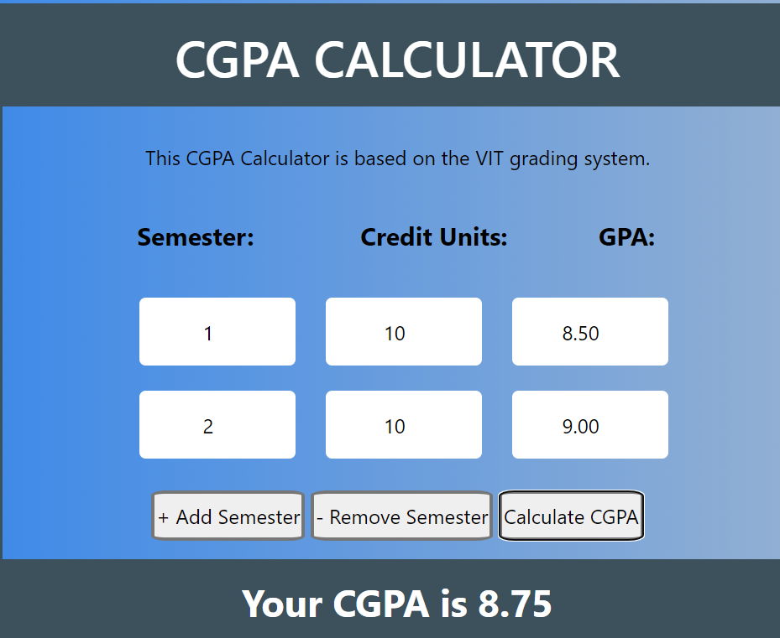

Slide 28
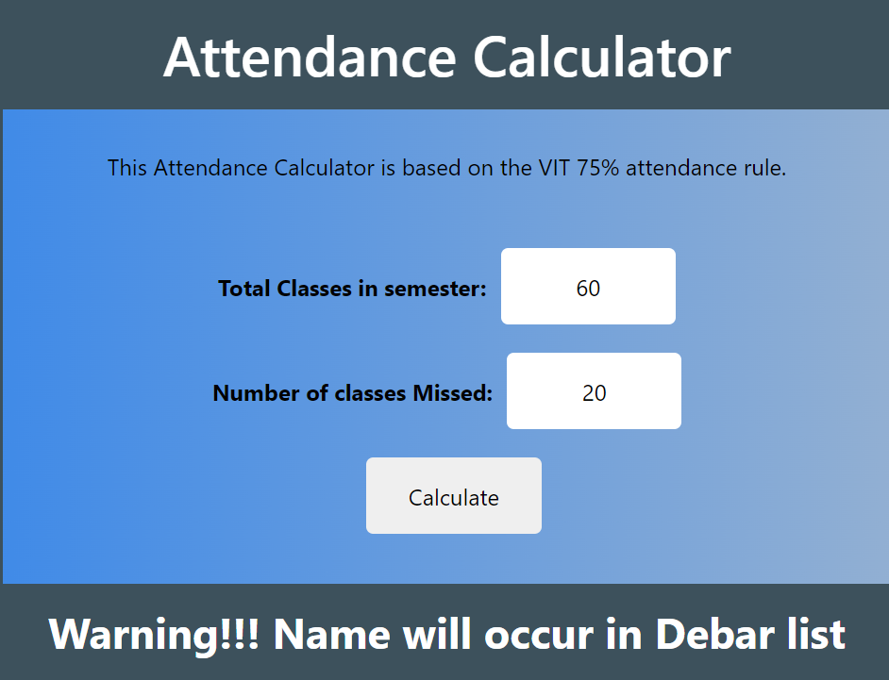

Slide 29
Result and Discussion
GPA calculator→ Here the user will input the course name, credits the course is allotted to and the grade he/she received, here the user will add the courses if he/she has studied more than one course and according to it the output will be produced
CGPA calculator→ Here the user will input the semester number, the total credits covering in that semester and the GPA achieved in that semester, the user can add the semester if he has covered more than one semester and according to it the output will be produced.
Attendance calculator→ Here the user will input the number of classes in semester and the total classes missed, according to that the output will be produced that how many classes the person can miss without appearing in the debar list
CGPA estimator→ Here the user will input the desired cgpa, current cgpa, credis taken, total credits till now, current sem, and user will get the that how many sem the user has to achieve how much GPA
Review System→ The user can post the review on any faculty of their choice and also retrieve the review but for this they have to sign in from the VIT Bhopal mail id.

Slide 30

Introduction
Objective
Proposal
Novelty
METHODOLOGY
Conclusion
The Main motive of this project is to put all the resources in one website so that the students of VIT mainly who are going through the Online classes get all the needed resources in one place. We have developed a Review system so that the students who are getting confused while doing FFCS procedure can get reviews of a faculty.
As the FFCS is the crucial procedure for every student hence it is needed that something should be there which tells students about the rating of any faculty so that it helps them to choose.

Slide 31

We are grateful to our respectable mentor Prof. Anand Motwani , whose insightful leadership and knowledge benefited us to complete this project successfully. Thank you so much for your continuous support and presence whenever needed.
Last but not the least, We would like to thank everyone who is involved in the project directly or indirectly.

Slide 32


